Slide 1
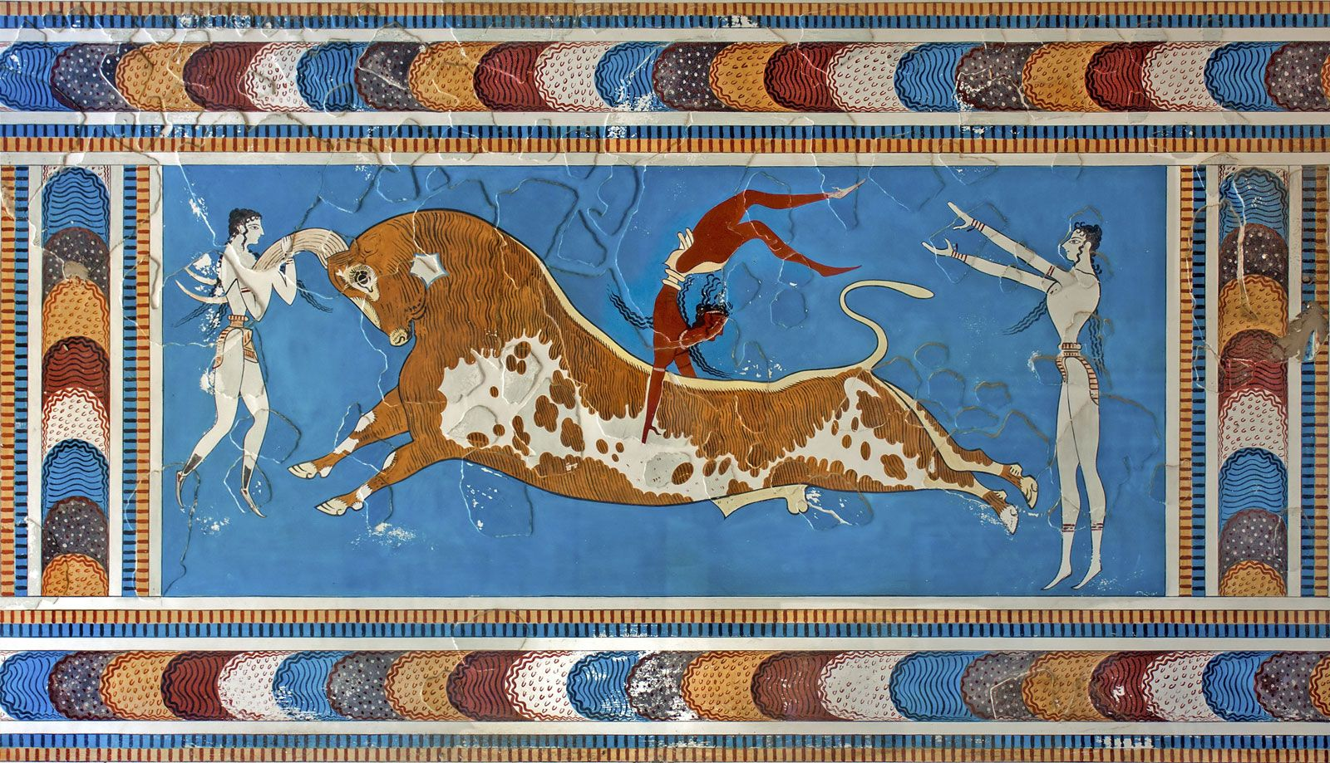
Theseus and the Minotaur
Goal/s:
Explain the significance of the minotaur myth
Week 2 Lesson 3
Ms Barrie

Slide 2
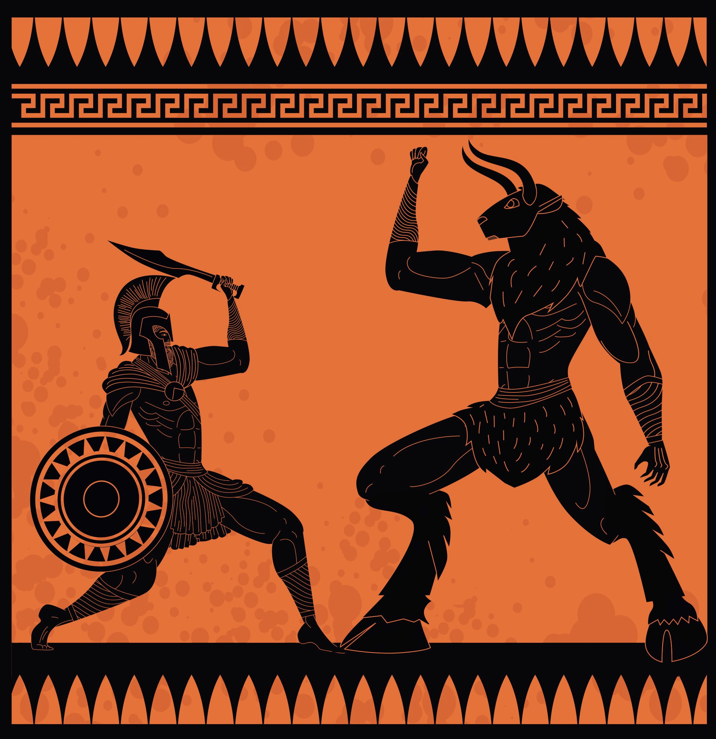
The myth of the Minotaur
REVIEW - What do you already know?

Slide 3
Today’s Lesson
We will be completing some SOURCE ANALYSIS practice together.
This is based on what we know about the Minoans, their mythology, and their cultural symbols.
1. Annotate sources
2. Source Analysis question types
(I do, We Do, You do)

Slide 4
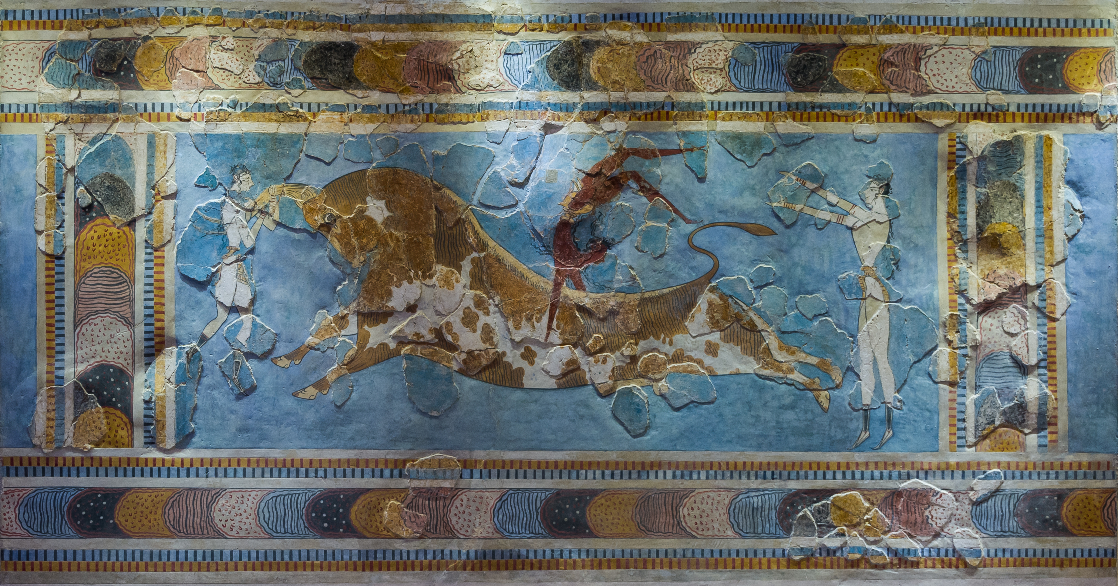
Sources of evidence - 1
I DO - ANNOTATE
The bull-leaping fresco. Found in Knossos palace, Crete, Greece. It dates around 1600 – 1450 BCE. By anonymous, CC0.
Notes:
The word labyrinth also bears ties to labrys, meaning “double ax,” which was the symbol of an important Minoan goddess and can be found represented throughout the palace at Knossos. Being that the palace was, in part, a sanctuary of “labrys,” it is easy to see the development of tales of the labyrinth. As the dominating Mediterranean power at the time, Crete could very well have demanded fourteen youths of exceptional character and honor, perhaps as hostages to ensure the loyalty of their subordinate nations, a common ancient practice. Yet another possibility is that those youths were indeed intended as human sacrifices to the gods, a sacrifice performed by a priest wearing a bull’s head – a true “Minotaur.”

Slide 5
Sources of evidence - 1
WE DO - ANALYSE
Identify and discuss the historical context of Source 1.
You should consider the following where appropriate: relevant event/s, significant person/people, key idea/s depicted in the source. (4 marks)
The bull-leaping fresco. Found in Knossos palace, Crete, Greece. It dates around 1600 – 1450 BCE. By anonymous, CC0.

Slide 6
Sources of evidence - 1
YOU DO - RESPOND
Identify and discuss the historical context of Source 1.
You should consider the following where appropriate: relevant event/s, significant person/people, key idea/s depicted in the source.
The historical context of Source 1 is…
THEN EXPLAIN THE STORY! KEY PEOPLE/EVENTS/IDEAS SHOWN.
The bull-leaping fresco. Found in Knossos palace, Crete, Greece. It dates around 1600 – 1450 BCE. By anonymous, CC0.

Slide 7
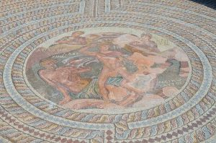
Sources of evidence - 2
I DO - ANNOTATE
Mosaic depicting the duel between Theseus and Minotaur. House of Theseus, 3rd-4th century AD, Paphos. By Carole Raddato. CC BY-SA 2.0.

Slide 8
Sources of evidence - 2
WE DO - ANALYSE
Identify and explain the message/s of Source 2. Provide evidence in your response. (4 marks)
Mosaic depicting the duel between Theseus and Minotaur. House of Theseus, 3rd-4th century AD, Paphos. By Carole Raddato. CC BY-SA 2.0.

Slide 9
Sources of evidence - 2
YOU DO - RESPOND
Identify and explain the message/s of Source 2. Provide evidence in your response. (4 marks)
The message of Source 2 is…
THEN EXPLAIN THE MESSAGE AND HOW THE SOURCE SHOWS THE MESSAGE (EVIDENCE)
Mosaic depicting the duel between Theseus and Minotaur. House of Theseus, 3rd-4th century AD, Paphos. By Carole Raddato. CC BY-SA 2.0.

Slide 10
Sources of evidence - 1
YOU DO - RESPOND
The historical context of Source 1 is the Minoan bull-leaping ritual based on the myth of the Minotaur. The Minoans were an Ancient Greek civilisation who existed on Crete in Greece between 2100 and 1100 BCE. The myth of the Minotaur had large cultural and religious significance to the Minoans. Minoan males would leap over or wrestle a bull to show they were men (coming-of-age ritual) to demonstrate their power over the bull, and also the importance of the myth to their society.
The bull-leaping fresco. Found in Knossos palace, Crete, Greece. It dates around 1600 – 1450 BCE. By anonymous, CC0.

Slide 11
Sources of evidence - 2
YOU DO - RESPOND
The message of Source 2 is that the myth of Theseus and the Minotaur was important to the Minoans as it was depicted in art work. The source depicts Theseus battling the Minotaur – a myth that impacted the daily life, religion, and culture of the Minoans. The time and detail of the myth shown in Source 2 – a mosaic – demonstrates that this story was highly significant to the Minoans in Ancient Greece. Mosaics were very difficult to make, so the attention to small detail over the large size of this artwork highlights this point.
Mosaic depicting the duel between Theseus and Minotaur. House of Theseus, 3rd-4th century AD, Paphos. By Carole Raddato. CC BY-SA 2.0.

